Slide 1
Digital Logic Design and Application (数字逻辑设计及应用)
Chapter 4 Combinational Logic Design Principles
(组合逻辑设计原理)
Basic Logic Algebra
(逻辑代数基础)
Combinational-Circuit Analysis
(组合电路分析)
Combinational-Circuit Synthesis
(组合电路综合)

Slide 2
Review of Chapter 3
Digital Logic Design and Application (数字逻辑设计及应用)
Electronic Behavior of CMOS Circuits
Logic Voltage Levels (逻辑电压电平)
DC Noise Margins (直流噪声容限)
Fan-In（扇入）
Fun-Out (扇出)

Slide 3
Review of Chapter 3
Digital Logic Design and Application (数字逻辑设计及应用)
Transmission Gates (传输门)
Schmitt-Trigger Inputs （Hysteresis）
Three-State Outputs (Tri-State output)
Open-Drain Outputs
(Open-Collector Gate)
A
EN_L
Z
B
EN
逻辑符号
A
B
A
OUT
EN

Slide 4
Review of Chapter 3
Digital Logic Design and Application (数字逻辑设计及应用)
Logic Levels
CMOS(0-1.5V, 3.5-5V)
TTL(0-0.8V, 2-5V)
ECL(L=-1.8V,
H=-0.9V)
(L=3.6V,
H=4.4V)
V_{OHmin}
HIGH (高态)
ABNOMAL
(不正常状态)
LOW (低态)
V_{IHmin}
V_{ILmax}
V_{OLmax}

Slide 5
Review of Chapter 3
Digital Logic Design and Application (数字逻辑设计及应用)
Wired AND (线与)
Open-Drain Outputs
(Open-Collector Gate)
Wired OR (线或)
Emitter-Coupled Logic Gate
（ECL, 发射极耦合逻辑门）
A
Z
B

Slide 6
Digital Logic Design and Application (数字逻辑设计及应用)
Review of Chapter 3
Positive Logic and Negative Logic
(正逻辑和负逻辑)
Three basic logic functions: AND, OR, and NOT
(三种基本逻辑：与、或、非)
Vcc
R
V_{OUT}
V_{IN}
获得高、低电平的基本原理

Slide 7
Review of Chapter 3 (第三章内容回顾)
Digital Logic Design and Application (数字逻辑设计及应用)
Three kinds of Description Method
(三种描述方法)：
Truth Table (真值表)
Logic Expression (逻辑表达式)
Logic Circuit (逻辑符号)
NAND and NOR (与非和或非)

Slide 8
Digital Logic Design and Application (数字逻辑设计及应用)
Basic Concepts (基本概念)
Two Types of Logic Circuits(逻辑电路分为两大类):
Combinational Logic Circuit（组合逻辑电路）
Sequential Logic Circuit（时序逻辑电路）
Outputs depend only on its Current Inputs.
(任何时刻的输出仅取决与当时的输入)
电路特点：无反馈回路、无记忆元件
Outputs depends not only on the current Inputs but also on the Past sequence of Inputs.
(任一时刻的输出不仅取决与当时的输入，
还取决于过去的输入序列)

Slide 9
4.1 Switching Algebra (开关代数)
Digital Logic Design and Application (数字逻辑设计及应用)
4.1.1 Axioms (公理)
X = 0 , if X ≠ 1 X = 1, if X ≠ 0
0’ = 1 1’ = 0
0·0 = 0 1+1 = 1
1·1 = 1 0+0 = 0
0·1 = 1·0 = 0 1+0 = 0+1 = 1
F = 0 + 1 · ( 0 + 1 · 0’ )’
= 0 + 1 · 1’

Slide 10
4.1.2 Single-Variable Theorems
(单变量开关代数定理)
Digital Logic Design and Application (数字逻辑设计及应用)
Identities (自等律)：X + 0 = X X · 1 = X
Null Elements (0-1律)：X + 1 = 1 X · 0 = 0
Involution (还原律)：( X’ )’ = X
Idempotency(同一律)：X + X = X X · X = X
Complements(互补律)：X + X’ = 1 X · X’ = 0
变量和
常量的
关系
变量和
其自身
的关系

Slide 11
4.1.3 Two-and Three-Variable Theorems (二变量或三变量开关代数定理)
Digital Logic Design and Application (数字逻辑设计及应用)
Similar Relationship with General Algebra
(与普通代数相似的关系)
Commutativity (交换律)
  A · B = B · A A + B = B + A
Associativity (结合律)
  A·(B·C) = (A·B)·C A+(B+C) = (A+B)+C
Distributivity (分配律)
  A·(B+C) = A·B+A·C A+B·C = (A+B)·(A+C)
可以利用真值表证明公式和定理

Slide 12
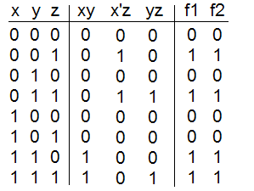
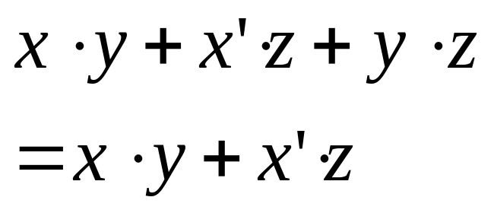
Perfect induction of the theorem
Use the truth table to prove the functions on both side are same !

Slide 13
Notes (几点注意)
Digital Logic Design and Application (数字逻辑设计及应用)
不存在变量的指数 A·A·A ≠ A³
允许提取公因子 AB+AC = A(B+C)
没有定义除法
if AB=BC ➔ A=C ??
错！
A=1, B=0, C=0
AB=AC=0, A≠C
没有定义减法
if A+B=A+C ➔ B=C ??
错！
A=1, B=0, C=1

Slide 14
Some Special Relationships
(一些特殊的关系)
Digital Logic Design and Application (数字逻辑设计及应用)
Covering (吸收律)
  X + X·Y = X X·(X+Y) = X
Combining (组合律)
  X·Y + X·Y’ = X (X+Y)·(X+Y’) = X
Consensus [添加律（一致性定理）]
  X·Y + X’·Z + Y·Z = X·Y + X’·Z
  (X+Y)·(X’+Z)·(Y+Z) = (X+Y)·(X’+Z)

Slide 15
Digital Logic Design and Application (数字逻辑设计及应用)
对上述的公式、定理要熟记，做到举一反三
A + A’ = 1
(X+Y) + (X+Y)’ = 1
代入定理：
在含有变量 X 的逻辑等式中，如果将式中所有出现 X 的地方都用另一个函数 F 来代替，则等式仍然成立。
X·Y + X·Y’ = X
(A’+B)·(A·(B’+C)) + (A’+B)·(A·(B’+C))’ = (A’+B)

Slide 16
Digital Logic Design and Application (数字逻辑设计及应用)
Prove (证明)： X·Y + X’·Z + Y·Z = X·Y + X’·Z
Y·Z = 1·Y·Z
= (X+X’)·Y·Z
X·Y + X’·Z + (X+X’)·Y·Z
= X·Y + X’·Z + X·Y·Z +X’·Y·Z
= X·Y·(1+Z) + X’·Z·(1+Y)
= X·Y + X’·Z

Slide 17
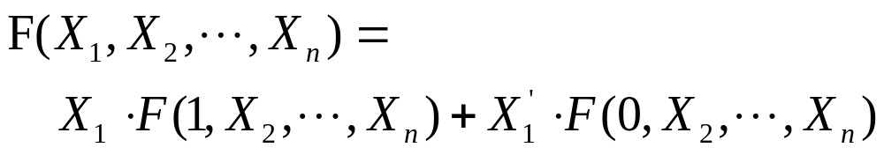
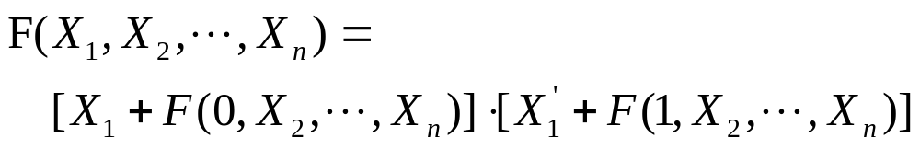
4.1.4 n-Variable Theorems
(n变量定理)
Digital Logic Design and Application (数字逻辑设计及应用)
Generalized idempotency theorem
( 广义同一律 )
  X + X + … + X = X X · X · … · X = X
Shannon’s expansion theorems
( 香农展开定理 )

Slide 18
Digital Logic Design and Application (数字逻辑设计及应用)
Prove (证明)：
A·D + A’·C + C·D + A·B’·C·D = A·D + A’·C
= A · ( 1·D + 1’·C + C·D + 1·B’·C·D ) +
A’ · ( 0·D + 0’·C + C·D + 0·B’·C·D )
= A · ( D + C·D + B’·C·D ) +
A’ · ( C + C·D )
= A·D·( 1 + C + B’·C ) + A’·C·( 1 + D )
= A·D + A’·C

Slide 19
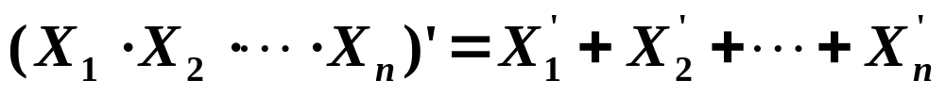
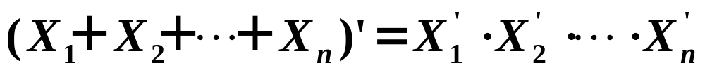
4.1.4 n-Variable Theorems
( n变量定理 )
Digital Logic Design and Application (数字逻辑设计及应用)
Demorgan’s Theorems (摩根定理)
—— Complement Theorems (反演定理)
(A · B)’ = A’ + B’
(A + B)’ = A’ · B’

Slide 20
Digital Logic Design and Application (数字逻辑设计及应用)
Complement Rules (反演规则)：
  · ⇔+，0 ⇔ 1，Complementing Variables
  ( 变量取反 )
  Follow the Priority Sequence as Before
  ( 遵循原来的运算优先次序 )
  Keep the complement Symbol of Non-single variables
  ( 不属于单个变量上的反号应保留不变 )

Slide 21
合理地运用反演定理能够将一些问题简化
Example 1：Write the Complement function for each of
The Following Logic functions. (写出下面函数的反函数 )
F1 = A · (B + C) + C · D
F2 = (A · B)’ + C · D · E’
Example 2：Prove (A·B + A’·C)’ = A·B’ + A’·C’

Slide 22
Digital Logic Design and Application (数字逻辑设计及应用)
合理地运用反演定理能够将一些问题简化
Prove：AB + AC = AB + AC
(A+B)(A+C)
AA +AC + AB + BC
AC + AB + BC
AB + AC + BC = AB + AC
AC + AB

Slide 23
4.1.5 Duality (对偶性)
Digital Logic Design and Application (数字逻辑设计及应用)
F^{D}(X₁ , X₂ , … , X_{n} , + , · , ’ )
= F(X₁ , X₂ , … , X_{n} , · , + , ’ )
Duality Rule ( 对偶规则 )
  · ⇔ +；0 ⇔ 1
  变换时不能破坏原来的运算顺序（优先级）
Principle of Duality ( 对偶原理 )
  若两逻辑式相等，则它们的对偶式也相等
X + X · Y = X
X · X + Y = X
X + Y = X
例： Write the Duality function for each
of the following Logic functions.
(写出下面函数的对偶函数)
F1 = A + B · (C + D)
F2 = ( A’·(B+C’) + (C+D)’ )’
X · ( X + Y ) = X

Slide 24
4.1.5 Duality (对偶性)
Digital Logic Design and Application (数字逻辑设计及应用)
Duality Rule ( 对偶规则 )
  · ⇔ +；0 ⇔ 1
  变换时不能破坏原来的运算顺序（优先级）
Principle of Duality ( 对偶原理 )
  若两逻辑式相等，则它们的对偶式也相等
证明公式：A+BC = (A+B)(A+C)
A(B+C)
AB+AC

Slide 25
Two kind of logic
Positive logic : 1 ( high level ) 0 (low level)
Negative logic: 0 ( high level ) 1 (low level)
If a logic relation exist in positive logic, it must be exist in negative logic. Both logic are duality for each other.
Positive-Logic Convention and Negative-Logic Convention
Are Duality (正逻辑约定和负逻辑约定互为对偶关系)

Slide 26
Duality and Complement
(对偶和反演)
Digital Logic Design and Application (数字逻辑设计及应用)
Duality (对偶)：F^{D}(X₁ , X₂ , … , X_{n} , + , · , ’ )
= F(X₁ , X₂ , … , X_{n} , · , + , ’ )
Complement (反演)： [ F(X₁ , X₂ , … , X_{n} , + , · ) ]’
= F(X₁’ , X₂’, … , X_{n}’ , · , + )
[ F(X₁ , X₂ , … , X_{n}) ]’ = F^{D}(X₁’ , X₂’, … , X_{n}’ )

Slide 27
第4章作业（P230）
Digital Logic Design and Application (数字逻辑设计及应用)
4.4 T8’
4.5
4.6
4.7 (d) (i)
4.8 (c) (h)
补充：写出 4.7 (c) 4.8 (g) 的对偶式和反演式

Slide 28
A Class Problem ( 每课一题 )
Digital Logic Design and Application (数字逻辑设计及应用)
Write the Duality and Complement function for each of the following Logic functions.
(分别写出下面函数的对偶函数和反函数)
F1 = A’ · (B + C) + C’ · D
F2 = ( A·(B+C’) + (C+D)’ )’

